Slide 1
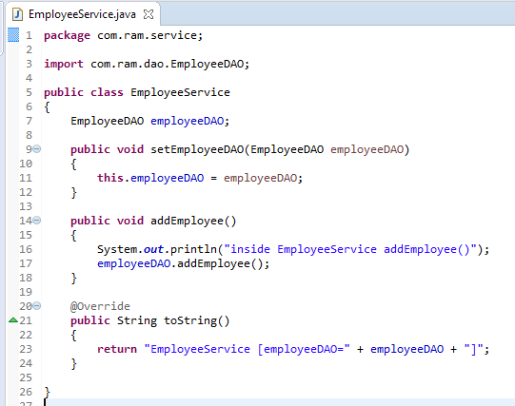
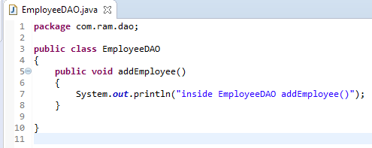
Declares Components Manually
Normally we declare all the beans or components in XML bean configuration file, so that Spring container can detect and register your beans or components. Actually, Spring is able to auto scan, detect and instantiate your beans from pre-defined project package, no more tedious beans declaration in in XML file.
Following is a simple Spring project, including a Employee service and dao layer. Let’s explore the different between declare components manually and auto components scanning in Spring.

Slide 2
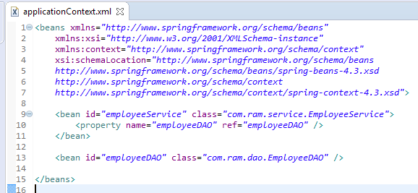
Declares Components Manually

Slide 3
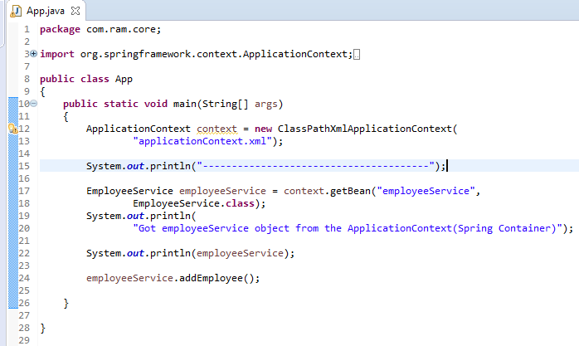
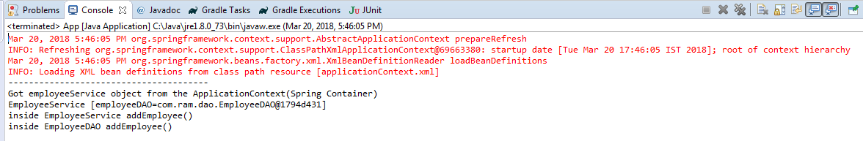
Declares Components Manually

Slide 4
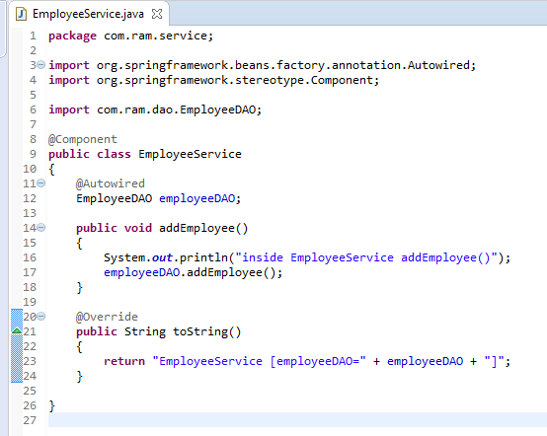
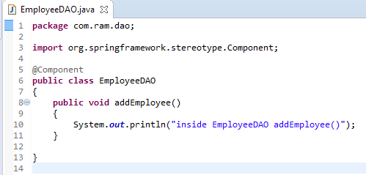
Auto Components Scanning
Annotate with @Component to indicate this class is an auto scan component.

Slide 5
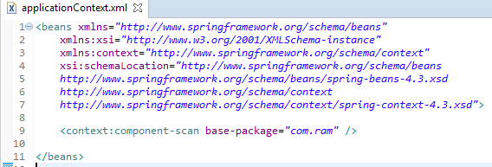
Auto Components Scanning
Add this “context:component” in bean configuration file, it means, enable auto scanning feature in Spring.
The base-package is indicate where are your components stored, Spring will scan this folder and create the bean (annotated with @Component) and register it in Spring container.

Slide 6
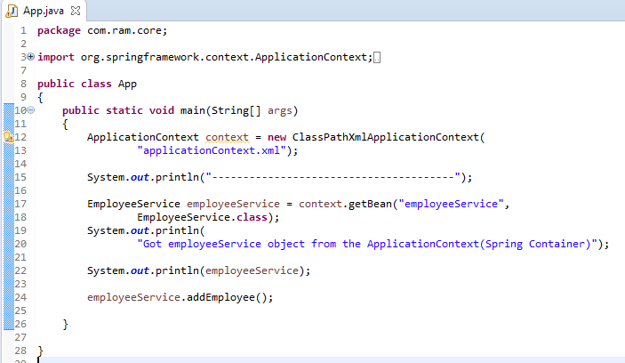
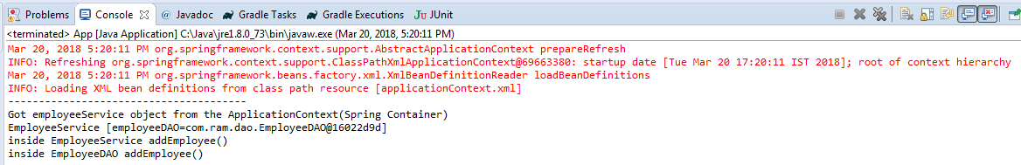
Auto Components Scanning

